Slide 1

“trendAssist” Finance and Business Prediction Program
Cade Wall
Mayur Bhakta
Aaron Turner
Aaron Riggs
Carolyn Wu
Andre Manz
A Project Proposal by Flying Mongeese

Slide 2
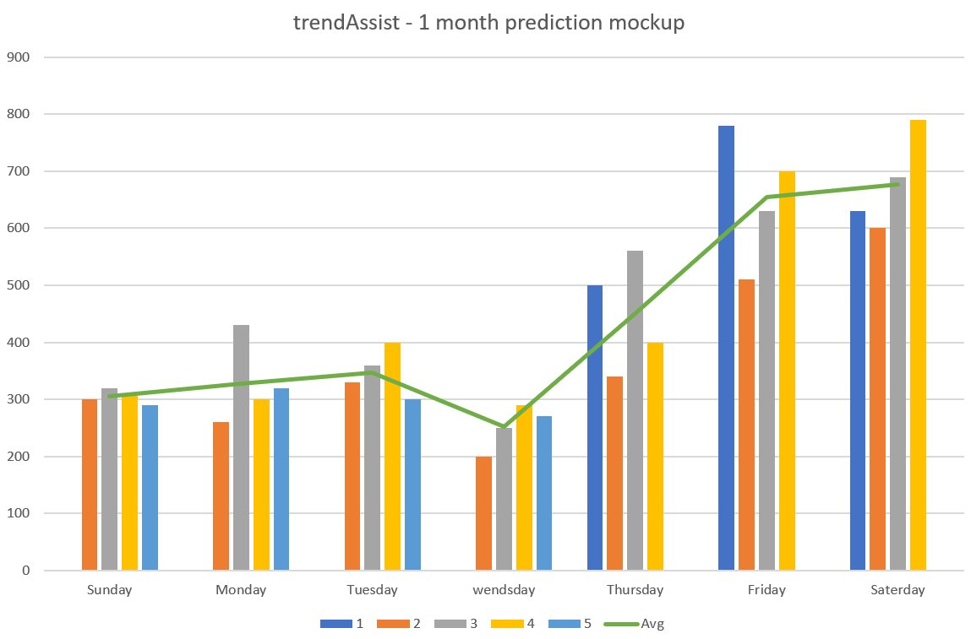
How does our application help your company?
trendAssist uses the power of trend prediction to help your company live long and prosper in a dynamic, ever-changing world.

Slide 3
Business finance and trend prediction program including the following...
Sales data forecast generator
Optimal amount of staff needed for any given date
Account and data security implemented through differing authorization levels
Unique, original concept for increasing small business financial efficiency
Overview
Notes:
trendAssist is a business finance and trend prediction program that allows the user to input data over sales made in a day; this data will then be submitted into a database containing financial sales data for every day of the week. It will also allow the user to input data in years past to increase the accuracy of sales predictions; the program will then use this information to generate a new estimation of revenue for that same day of the week in the future and describe requirements needed to hit specific profit margins. This will enable the user (owner or manager) to determine the optimal staffing needed on any given day to support the expected crowd and maximize profits. The most recent year’s data will be weighted higher than the previous year’s data to maintain accuracy and adjust for recent trends.

Slide 4
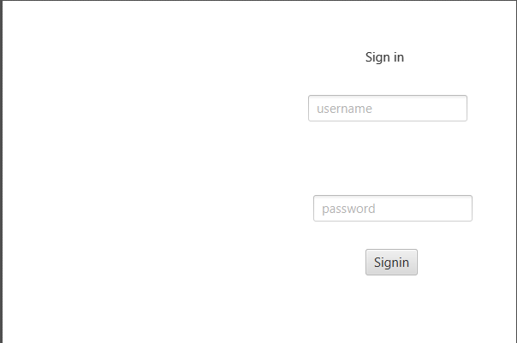
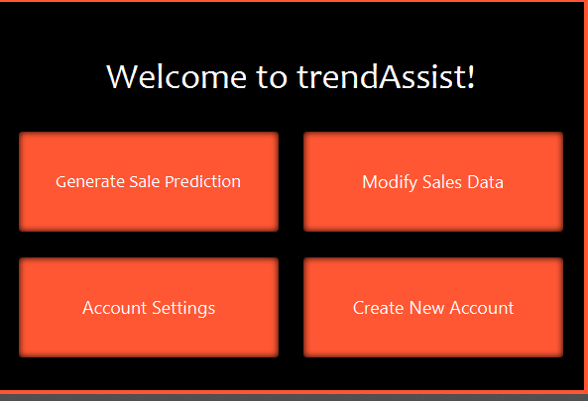
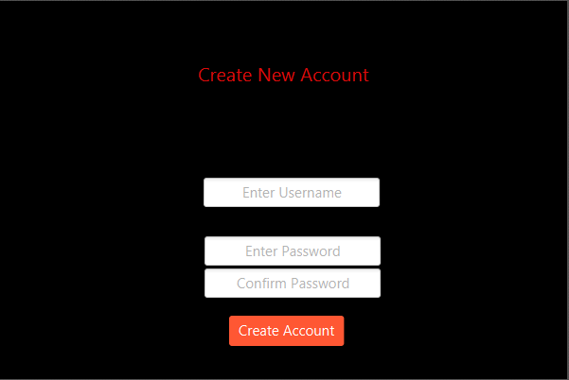
Ease and Simplicity
Tentative Program GUI
with differing color schemes

Slide 5


Q&A

